Slide 1
C Developing

Slide 2
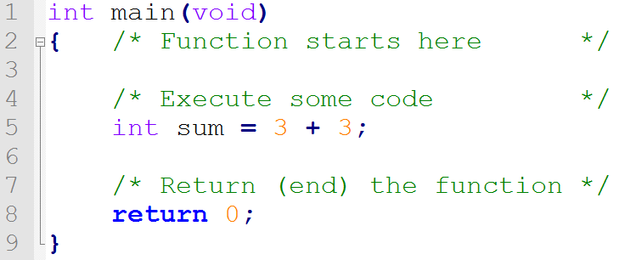
How Code Executes
Code executes from the top
Evaluates a line at a time as it goes

Slide 3
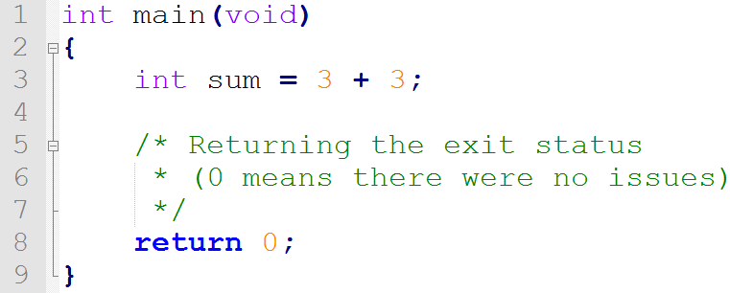
main?
main is the starting and ending point of all C programs
There can only be one
Provides an exit status to the operating system (was there an error or not)

Slide 4
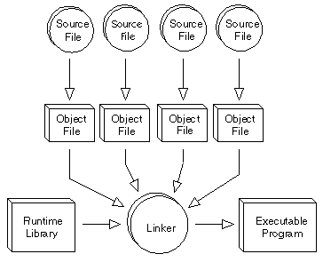
Creating An Executable
Step-by-Step process
Creating/Editing the source file (.c)
Preprocessing the source file (.i)
Compiling to an assembly file (.s)
Assembling into an object file (.o)
Linking to an executable file (.exe)
Executing the program
Normally, this will all be done behind the scenes.

Slide 5
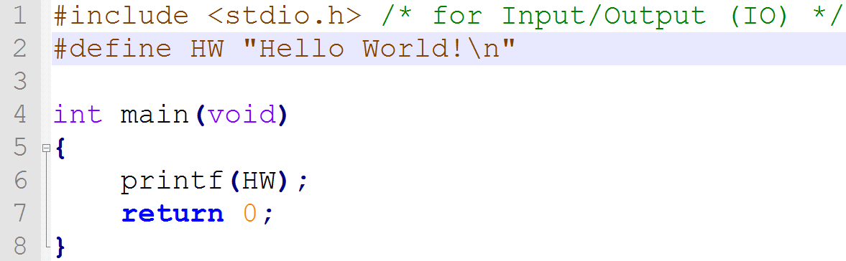
Preprocessing
Look for # sign, these are Preprocessor Directives
Most common directives:
#include – includes the code from one file in another
#define – replace text with something

Slide 6
A Note on #include
You should never include .c files, only .h files
Use angle brackets ( <header.h> ) for files not in the current directory
For example, any std file (stdio.h, stdlib.h, etc.)
Use quotes (“header.h”) for files in the current directory
These are generally ones you’ve created yourself

Slide 7
Compiling/Assembling
Translates source code (text) to object code (binary)
This produces object files (helloworld.c → helloworld.o)

Slide 8
Linking
“Links” multiple object files into an executable (helloworld.o → helloworld.exe)
Once in .exe, the program can now be ran

Slide 9
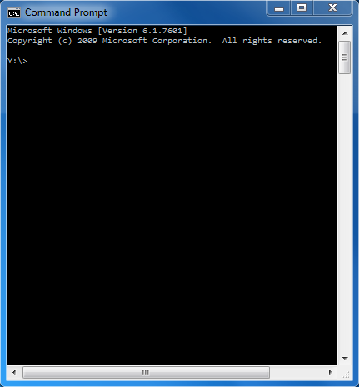
Command Line / Terminal
A different way to interact with the computer
All programs use the command line
Programs can be ran directly from the command line
Common Commands include:
CLS – Clear the screen
CD – Change directory
MKDIR – Make directory
DEL – Deletes a file
DIR – Displays files in a directory

Slide 10
Development Environment (for our Class)
Notepad++
Text Editor
Used for writing code
Command line
Compile, link, and execute
GCC
Our compiler and linker (There are more)

Slide 11
Summary
Code runs from the top down, evaluating line-by-line
We need one and only one main to begin/end or program
There’s a lot of steps to compiling, but thankfully our compilers do them for us

Slide 12
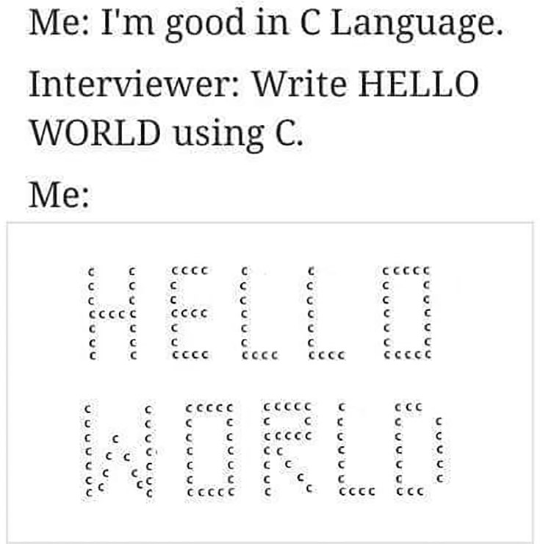
Questions?

